Slide 1
LED Materials
Prepared By Dr.Christeena Joseph
Associate Professor
Department of ECE

Slide 2
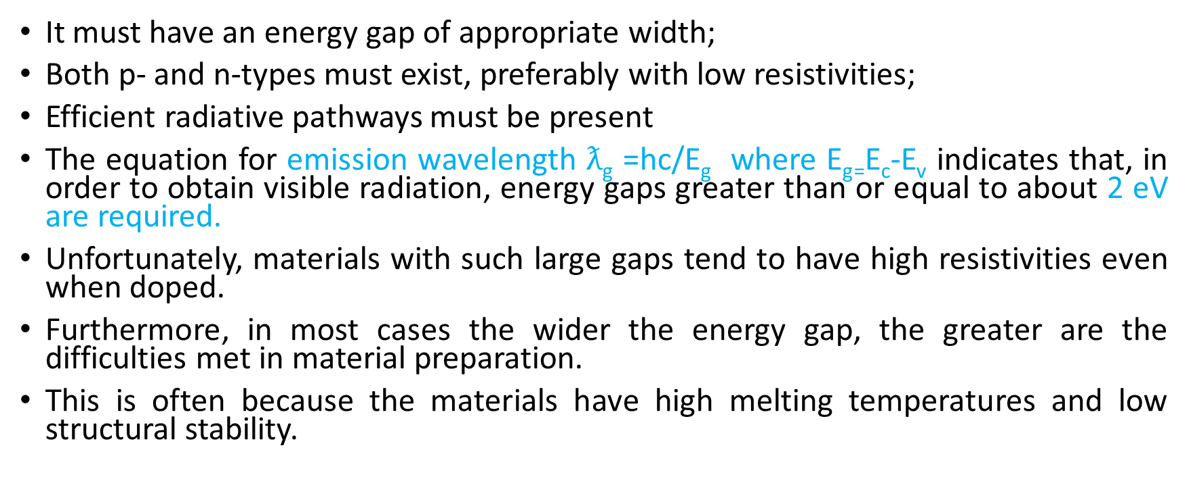
Requirements for a suitable LED material
It must have an energy gap of appropriate width;
Both p- and n-types must exist, preferably with low resistivities;
Efficient radiative pathways must be present
The equation for emission wavelength $ƛ$_{g} =hc/E_{g} where E_{g=}E_{c}-E_{v} indicates that, in order to obtain visible radiation, energy gaps greater than or equal to about 2 eV are required.
Unfortunately, materials with such large gaps tend to have high resistivities even when doped.
Furthermore, in most cases the wider the energy gap, the greater are the difficulties met in material preparation.
This is often because the materials have high melting temperatures and low structural stability.

Slide 3
Commercial LED materials

Slide 4
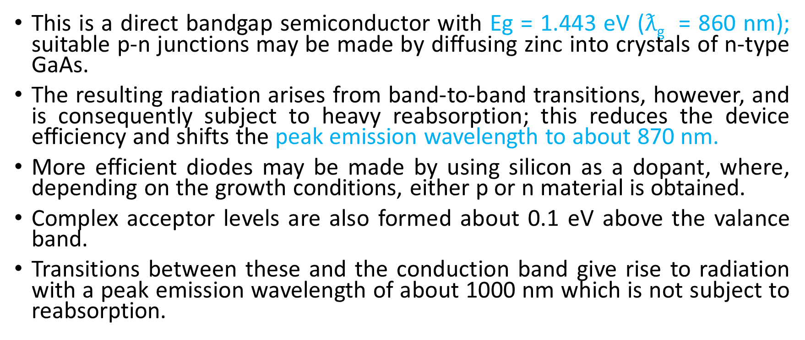
GALLIUM ARSENIDE (GaAs)
This is a direct bandgap semiconductor with Eg = 1.443 eV ($ƛ$_{g} = 860 nm); suitable p-n junctions may be made by diffusing zinc into crystals of n-type GaAs.
The resulting radiation arises from band-to-band transitions, however, and is consequently subject to heavy reabsorption; this reduces the device efficiency and shifts the peak emission wavelength to about 870 nm.
More efficient diodes may be made by using silicon as a dopant, where, depending on the growth conditions, either p or n material is obtained.
Complex acceptor levels are also formed about 0.1 eV above the valance band.
Transitions between these and the conduction band give rise to radiation with a peak emission wavelength of about 1000 nm which is not subject to reabsorption.

Slide 5
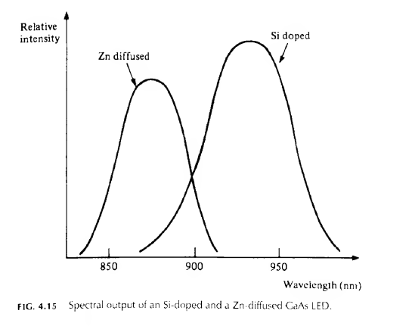
Typical emission spectra for both Zn-diffused and Si- doped diodes

Slide 6
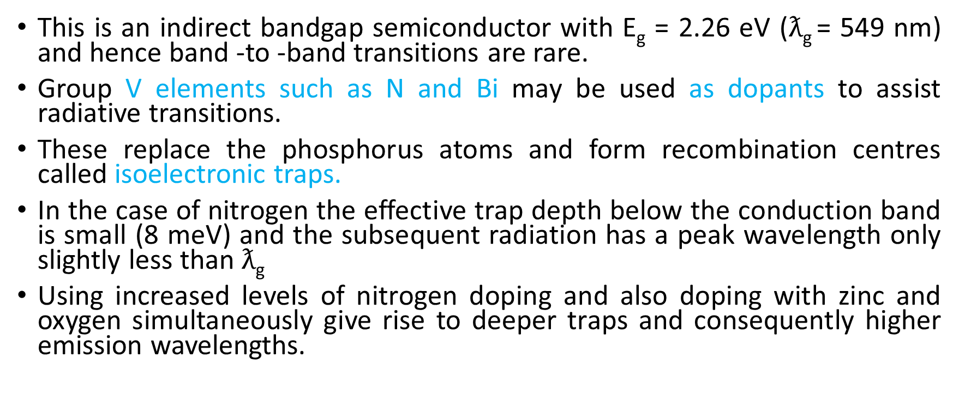
GALLIUM PHOSPHIDE (GaP)
This is an indirect bandgap semiconductor with E_{g} = 2.26 eV ($ƛ$_{g} = 549 nm) and hence band -to -band transitions are rare.
Group V elements such as N and Bi may be used as dopants to assist radiative transitions.
These replace the phosphorus atoms and form recombination centres called isoelectronic traps.
In the case of nitrogen the effective trap depth below the conduction band is small (8 meV) and the subsequent radiation has a peak wavelength only slightly less than $ƛ$_{g}
Using increased levels of nitrogen doping and also doping with zinc and oxygen simultaneously give rise to deeper traps and consequently higher emission wavelengths.

Slide 7
GALLIUM ARSENIDE PHOSPHIDE (GaAs_{1-x}P_{x},)
The energy gap of this ternary alloy depends on the value of x and furthermore it changes from being a direct bandgap when ,x< 0.45 to an indirect bandgap when ,x > 0.45.
Using diodes with x = 0.4 results in red emission.
The indirect bandgap material can also be used in conjunction with the same radiative assisting dopants as used in GaP

Slide 8
GALLIUM ALUMINIUM ARSENIDE (Ga_{x} AI_{1-x},As)
Highly efficient red- and near-infrared-emitting LEDs can be made from this material,if a heterojunction is formed between n-type Ga_{0.3}Al_{0.4}As and p type Ga_{0.6}Al_{0.4}As
As, electrons injected from the n surface layer into the p material recombine radiatively via acceptor levels and result in radiation of 650 nm wavelength.
This can pass through the surface layer with little attenuation because of the relative large bandgap of the latter.

Slide 9
III-V nitrides (e.g. GaN and AIN)
These materials have energy gaps that correspond to emission wavelengths from green all the way into the ultraviolet.
A number of problems frustrated the early development of these materials.
For example, until recently there was a lack of suitable substrate materials with matching lattice constants and thermal expansion coefficients. It also proved difficult to dope the materials p-type.
It was not until the early 1980s that these problems were overcome, when it was found that the deposition of buffer layers allowed growth on readily available substrates such as sapphire and silicon carbide.
In addition new growth and irradiation techniques have enabled p-type layers to be fabricated.

Slide 10
INDIUM GALLIUM ARSENIDE
High brightness LEDs are now commercially available based on InGaAs, although the structures (e.g. 'double heterostructures) are somewhat more complicated .
By increasing the indium content the emission wavelength increases, and radiation in the green can also be obtained with reasonably high efficiency.

Slide 11
II-VI semiconductors (e.g. zinc selenide and related compounds)
These materials have also been used successfully to make blue- and green-emitting diodes.
For example, green-emitting diodes have been made using ZnTeSe as an active region grown on a ZnSe substrate.
By replacing the ZnTeSe layer with one of ZnCdSe emission has been obtained in the blue.
However, these materials are much softer than the III- V nitrides and degrade more rapidly at elevated temperatures and consequently have shorter working lifetimes.

Slide 12
SILICON CARBIDE (SiC)
Silicon carbide has been a promising material for many years, but its high melting point and consequent growth difficulties prevented its early use in LEDs.
It can be doped as both n- and p-type and commercial blue-emitting diodes have been available for some years.
Doping with B, Al, Sc and Be gives rise to yellow, blue, green and red emission respectively.
However, efficiencies have always been very low and with the recent development of highly efficient InGaAs emitters.

Slide 13
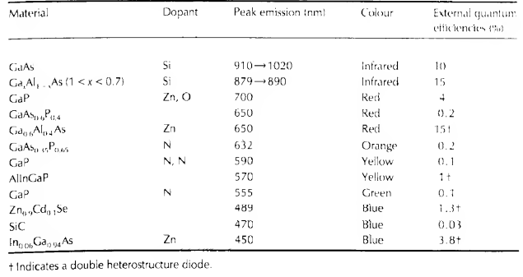
Characteristics of the commonly used LED Materials
External Quantum Efficiency (EQE):The ratio of the number of photons emitted from the LED to the number of electrons passing through the device - in other words, how efficiently the device coverts electrons to photons and allows them to escape
The Peak Emission Wavelength of an LED is the maximum wavelength of the photons that the LED emits

